Slide 1
REAL TIME PROJECT
FOOD DELIVERY WEB APPLICATION PROJECT

Slide 2
PROJECT TILTEL: ONLINE FOOD DELIVERY SYSTEM
Student Name : KETHAVATH SHILPA, E.SINDHU
Roll Number: 24WJ1A1253,24WJ1A1238
Guide: (Faculty Name)
Department: IT
Date: (28/March/2026)

Slide 3
INTRODUCTION
The Food Delivery Web Application is an online platform that allows users to order food from restaurants easily using a website. In today’s digital world, people prefer quick and convenient services, and this system helps in saving time by avoiding traditional phone-based or in-person ordering.
In conclusion, the Food Delivery Web Application represents a practical implementation of web development concepts and demonstrates how technology can be used to solve real-world problems. It not only benefits customers by providing convenience but also helps businesses expand their reach and improve service quality.
Food delivery apps are widely used today
Helps users order food online easily
Reduces time and effort
Digital transformation in restaurant services

Slide 4
PROBLEM STATEMENT
Traditional food ordering is time-consuming
Lack of real-time tracking
Manual errors in order handling
Limited restaurant reach
In today’s fast-paced world, people often find it difficult to spend time visiting restaurants or preparing food at home due to busy schedules. Traditional methods of food ordering, such as visiting restaurants physically or placing orders through phone calls, are inefficient and time-consuming. These methods also lack accuracy and transparency, as there is a high possibility of miscommunication between customers and restaurant staff.

Slide 5
OBJECTIVES
The main objective of this project is to develop a user-friendly and efficient web-based food delivery system that allows customers to order food online easily and enables restaurants to manage orders effectively.
Develop a user-friendly web app
Provide real-time food ordering
Enable online payments
Improve customer experience
To provide easy online food ordering Allow users to browse menus and order food from anywhere.
The main objective of this project is to develop a user-friendly and efficient web-based food delivery system that allows customers to order food online easily and enables restaurants to manage orders effectively.

Slide 6
EXISTING SYSTEM
Phone-based ordering
Limited menu visibility
No tracking system
Limitations
Slow process
Human errors
No automation

Slide 7
PROPOSED SYSTEM
Online platform for ordering food
Live order tracking
Digital payment integration
Admin dashboard

Slide 8
METHODOLOGY
Requirement analysis
Design (UI/UX)
Development
Testing
Deployment

Slide 9
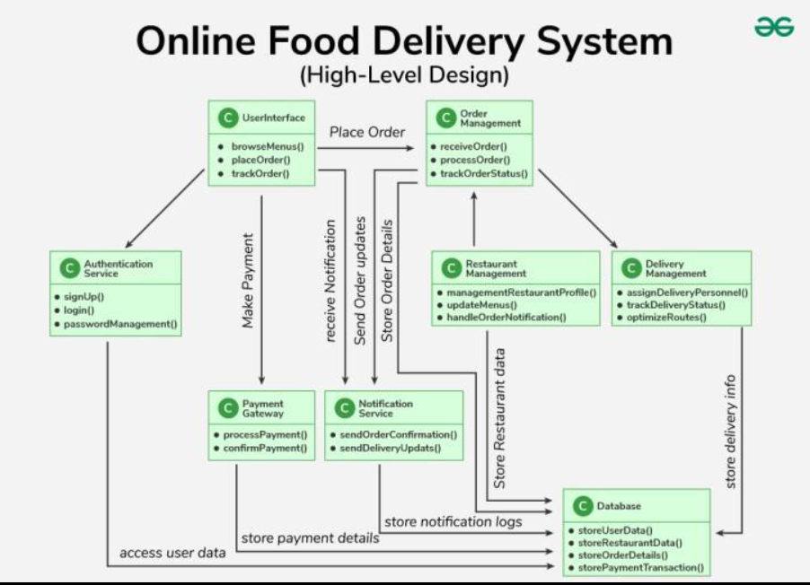
SYSTEM ARCHITECTURE
Frontend (User Interface)
Backend (Server)
Database (Storage)

Slide 10
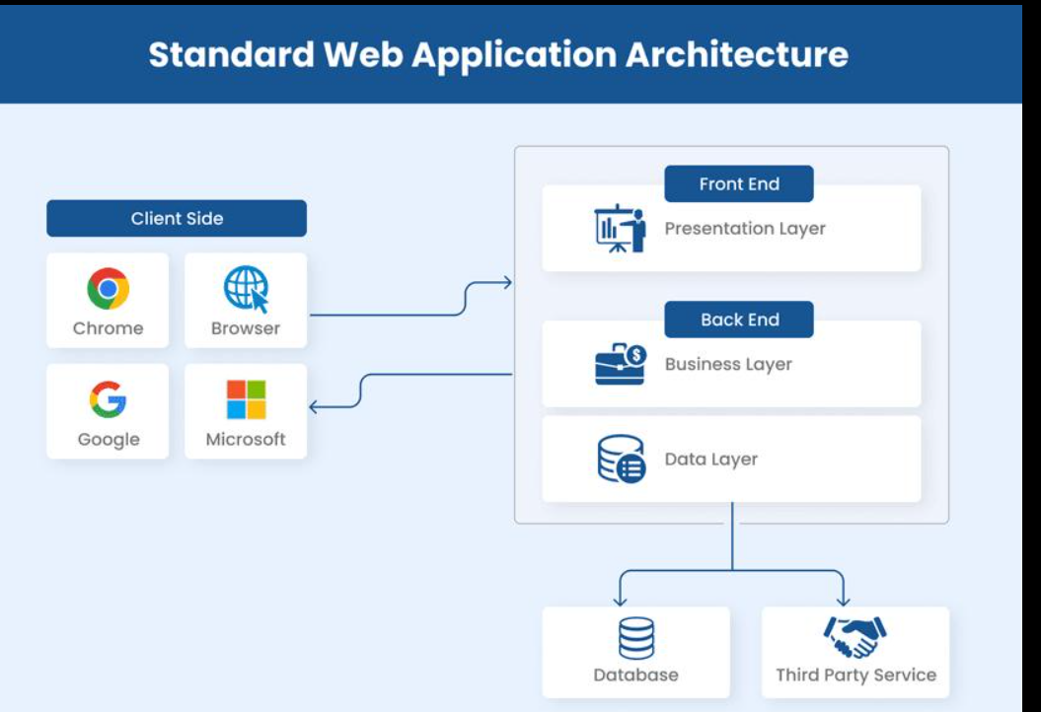
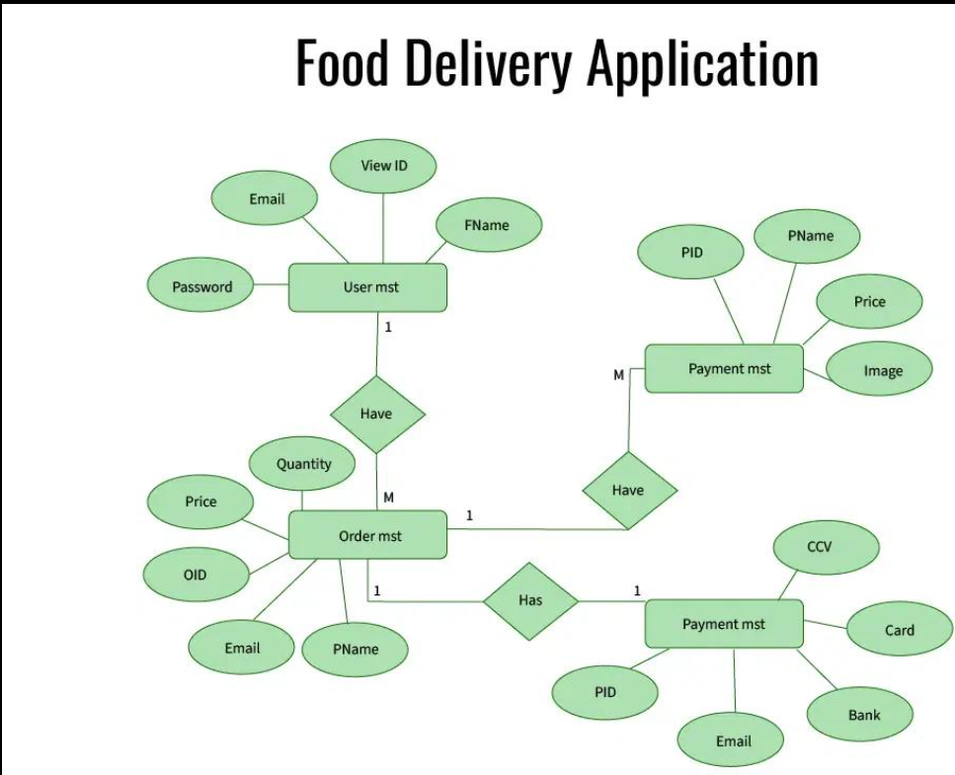
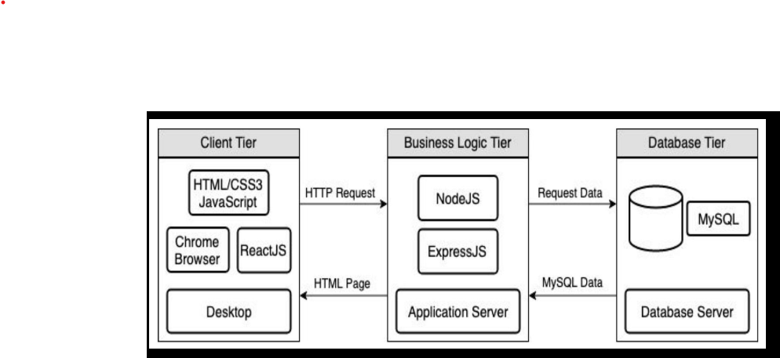

Slide 11
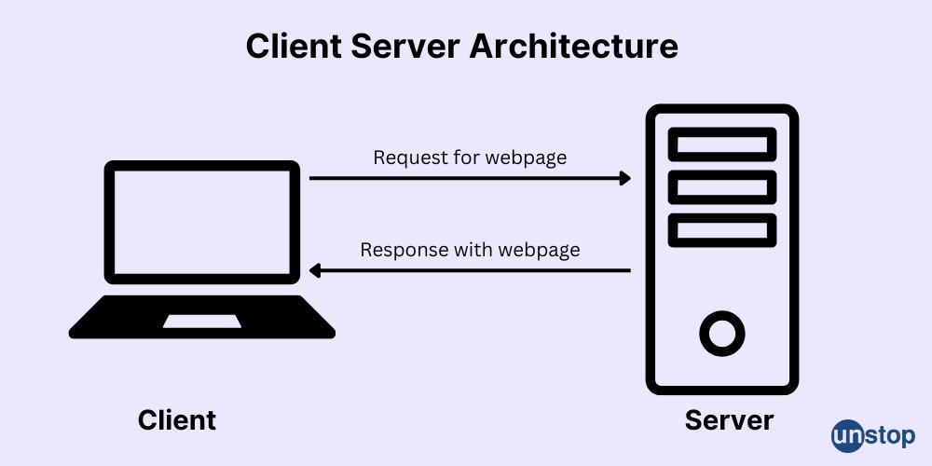
Explanation
Frontend (Client Side)
HTML, CSS, JavaScript
User Interface (UI)
Backend (Server Side)
Node.js / PHP
Handles requests & logic
Database
MySQL / MongoDB
Stores users & orders
Flow: User → Frontend → Backend → Database → Response → User

Slide 12
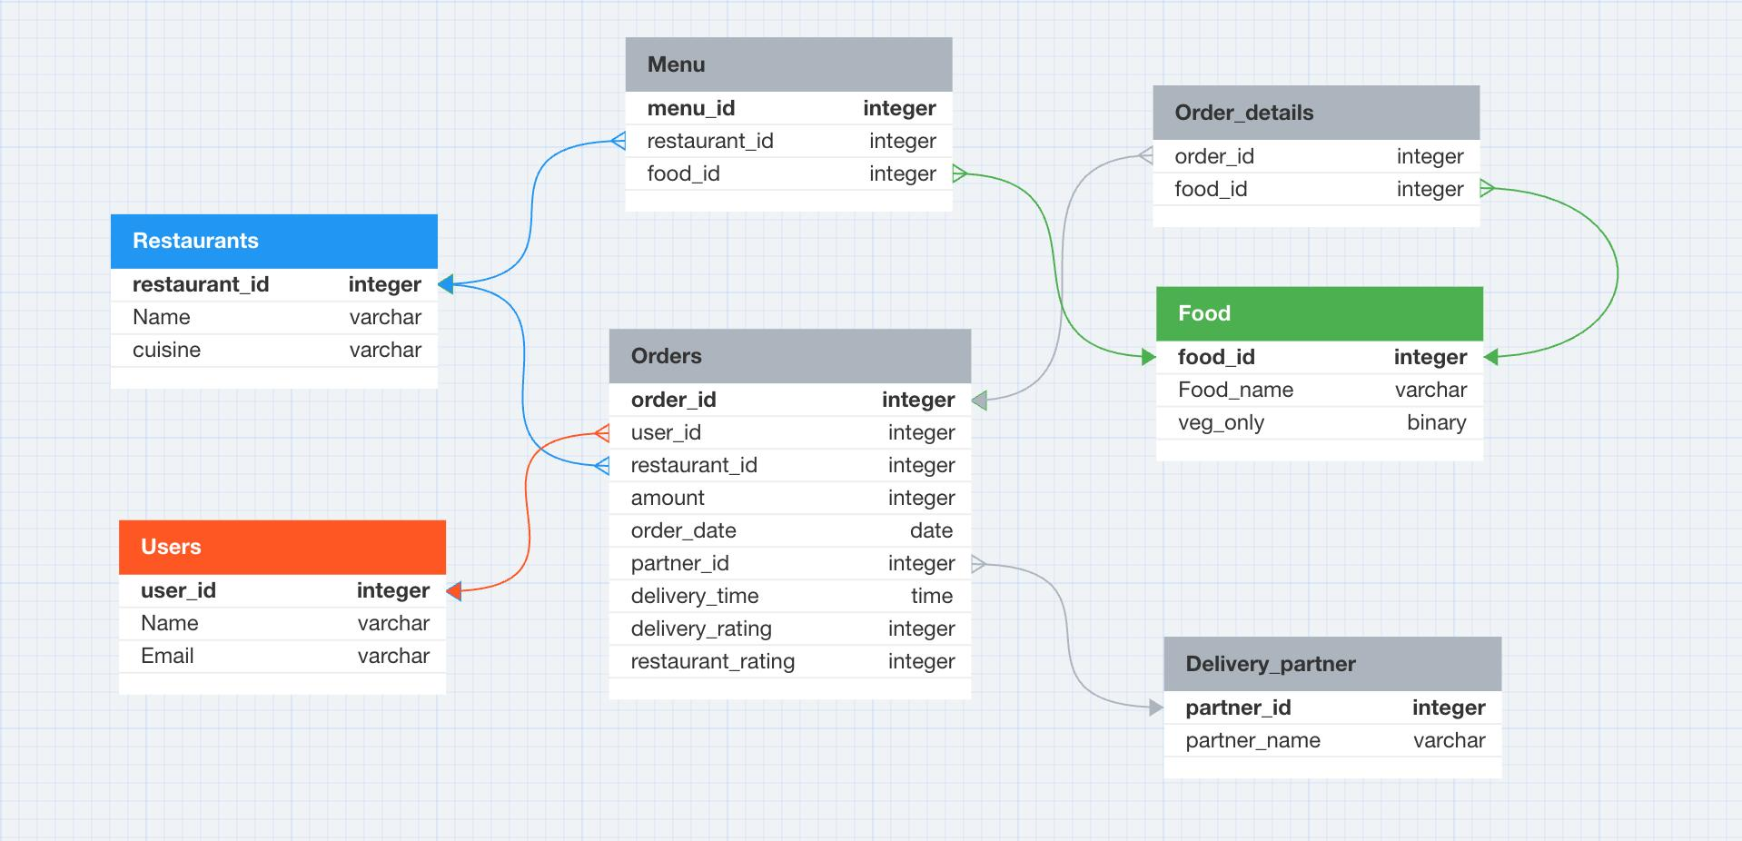
DATA FLOW DIAGRAM (DFD - LEVEL 0)
DFD Explanation
User → System (login, order)
System → Database (store data)
Admin → System (manage orders)
System → User (order confirmat

Slide 13
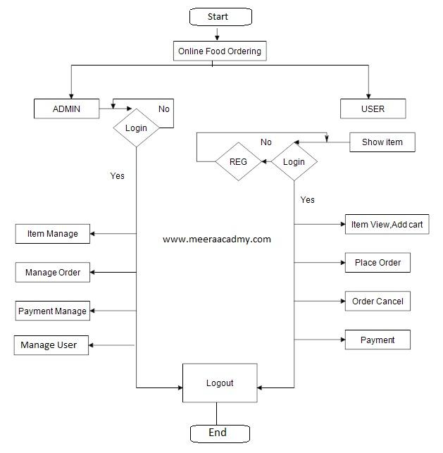
Flowchart (food ordering process)
Start
↓
User Opens Website
↓
Register / Login
↓
Browse Food Menu
↓
Select Food Items
↓
Add to Cart
↓
Checkout
↓
Place Order
↓
Order Stored in Database
↓
Admin Processes Order
↓
Food Delivered
↓
End

Slide 14
TOOLS & TECHNOLOGIES
HTML, CSS, JavaScript
React.js / Angular (Frontend)
Node.js / PHP (Backend)
MySQL / MongoDB (Database)

Slide 15
WORK PLAN / TIMELINE
Week 1–2: Planning
Week 3–5: Development
Week 6: Testing
Week 7: Deployment

Slide 16
EXPECTED OUTCOMES
Fast food ordering system
Improved customer satisfaction
Reduced manual work

Slide 17
CURRENT PROGRESS
UI designed
Login system completed
Basic database created

Slide 18
CHALLENGES
Payment integration issues
Server handling
Security concerns

Slide 19
PROJECT STRUCTURE
food-delivery/
│── index.html
│── login.html
│── register.html
│── dashboard.html
│── style.css
│── script.js
│── server.js
│── db.sql

Slide 20
FRONTEND CODE
index.html (Home Page)
<!DOCTYPE html>
<html>
<head>
<title>Food Delivery</title>
<link rel="stylesheet" href="style.css">
</head>
<body>
<h1>🍔 Food Delivery App</h1>
<div class="menu">
<div class="item">
<h2>Pizza</h2>
<p>₹200</p>
<button onclick="addToCart('Pizza')">Add</button>

Slide 21
</div> <div class="item"> <h2>Burger</h2> <p>₹150</p> <button onclick="addToCart('Burger')">Add</button> </div> </div> <button onclick="checkout()">Checkout</button> <script src="script.js"></script> </body> </html>
FOOD DELIVARY APP
Pizza
₹200
Burger
₹150
ADD
CHECKOUT

Slide 22
STYLE.CSS CSS
body {
font-family: Arial;
text-align: center;
background: #f5f5f5;
}
.menu {
display: flex;
justify-content: center;
}
.item {
border: 1px solid #ccc;
padding: 20px;
margin: 10px;

Slide 23
background: white;
}
button {
padding: 10px;
background: orange;
border: none;
cursor: pointer;
}

Slide 24
SCRIPT.JS
let cart = [];
function addToCart(item) {
cart.push(item);
alert(item + " added to cart");
}
function checkout() {
alert("Order placed: " + cart.join(", "));
}

Slide 25
LOGIN & REGISTER login.html
<!DOCTYPE html>
<html>
<head>
<title>Login</title>
</head>
<body>
<h2>Login</h2>
<form onsubmit="loginUser(event)">
<input type="text" id="username" placeholder="Username"><br><br>
<input type="password" id="password" placeholder="Password"><br><br>
<button type="submit">Login</button>

Slide 26
</form>
<script>
function loginUser(e) {
e.preventDefault();
alert("Login Successful");
window.location.href = "index.html";
}
</script>
</body>
</html>

Slide 27
REGISTER.HTML
<!DOCTYPE html>
<html>
<head>
<title>Register</title>
</head>
<body>
<h2>Register</h2>
<form onsubmit="registerUser(event)">
<input type="text" placeholder="Username"><br><br>
<input type="password" placeholder="Password"><br><br>
<button type="submit">Register</button>

Slide 28
</form>
<script>
function registerUser(e) {
e.preventDefault();
alert("Registered Successfully");
}
</script>
</body>
</html>

Slide 29
Backend (Node.js) server.js
const express = require('express');
const app = express();
const bodyParser = require('body-parser');
app.use(bodyParser.json());
let orders = [];
// API to place order
app.post('/order', (req, res) => {
const order = req.body;
orders.push(order);
res.send("Order placed successfully");
});

Slide 30
// API to get orders
app.get('/orders', (req, res) => {
res.json(orders);
});
app.listen(3000, () => {
console.log("Server running on port 3000");
});

Slide 31
DATABASE (MYSQL) db.sql
CREATE DATABASE food delivery ;
USE food delivery ;
CREATE TABLE users (
id INT AUTO_INCREMENT PRIMARY KEY,
username VARCHAR(50),
password VARCHAR(50)
);
CREATE TABLE orders (
id INT AUTO_INCREMENT PRIMARY KEY,
item VARCHAR(100),
user id INT
);

Slide 32
CONCLUSION
System improves efficiency
Easy to use
Scalable for future

